Slide 1
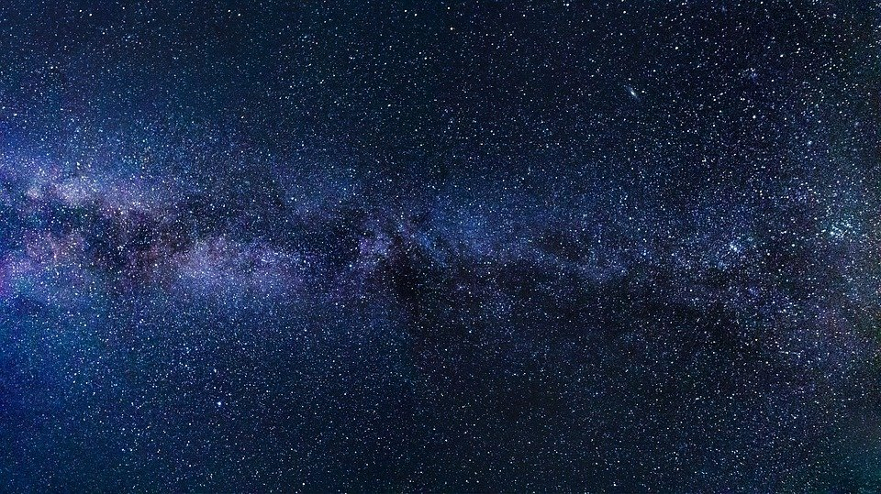
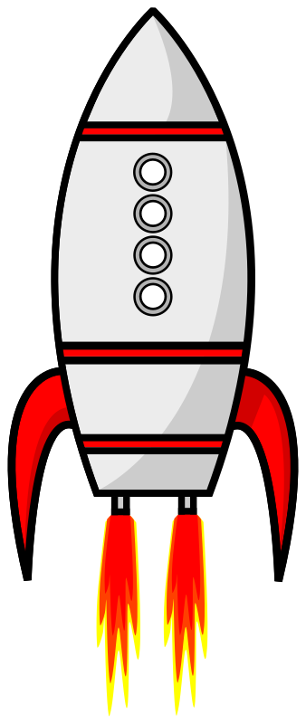
Forces in space challenge

Slide 2
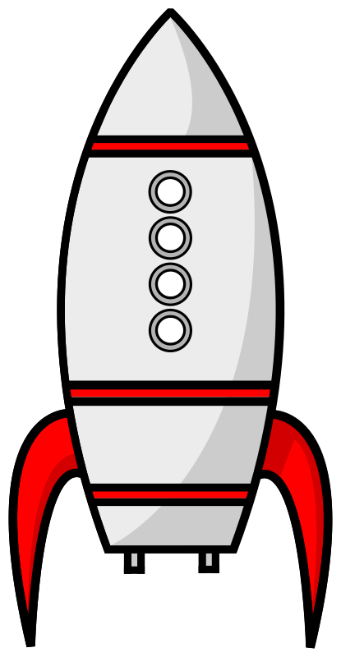
1.
If a rocket is launched from the Earth’s surface, it needs to reach a speed of at least 7900 m/s in order to leave Earth and reach space. This requires extremely large accelerations. Which is the correct expression for acceleration?
a) Time ÷ Change in Velocity
b) Change in Velocity ÷ Time
c) Velocity x Time

Slide 3
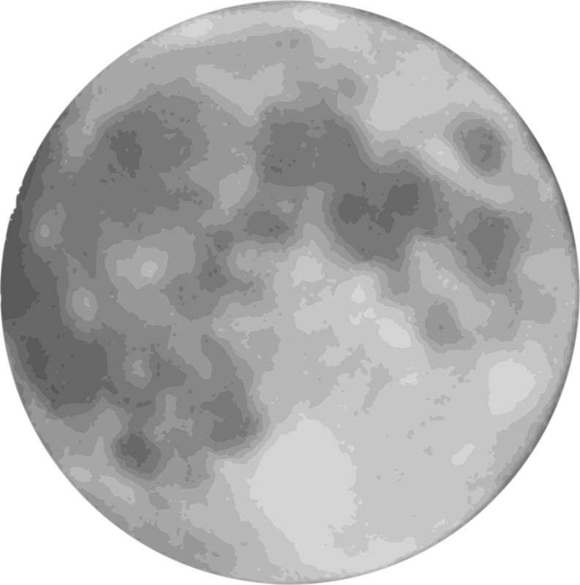
Not quite, try again!

Slide 4
2.
As the rocket is travelling through the Earth’s outer atmosphere at increasing speeds, is its acceleration in the same direction as its velocity?
Yes
No

Slide 5
Not quite, try again!

Slide 6
3.
The rocket has reached outer space within 8 minutes, this involved it travelling from 0 - 7900 m/s.
What was the rocket’s acceleration? Hint: convert the time into seconds!
a) 0.06 m/s²
b) 16.5 m/s²
c) 988 m/s²
d) 16.5 m/s

Slide 7
Not quite, try again!

Slide 8
4.
The rocket starts to decelerate. Which diagram shows the correct directions of the rocket’s velocity and acceleration?
velocity
acceleration
velocity
acceleration
a)
b)
c)
acceleration
velocity

Slide 9
Not quite, try again!

Slide 10
5.
There is artificial gravity and air within the rocket.
The astronaut inside the rocket slides a clipboard across a work bench.
Why does this come to a rest?
a) Due to gravity
b) Due to frictional forces
c) All forces acting on balance

Slide 11
Not quite, try again!

Slide 12
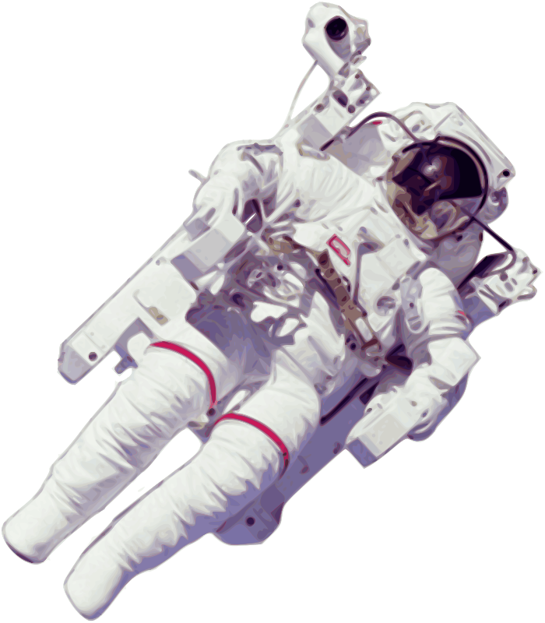
6.
The astronaut is outside and attached to the rocket. His spacesuit has no built-in jets to control his movement. Which of his thoughts is correct?
a)
If I become detached, I will eventually slow down until I stop moving, so the other astronauts can come to get me.
b)
It doesn’t matter if I become detached because I won’t move anywhere.
c)
If I become detached, there will be no force acting on me, so I will move away forever with a constant velocity. So, I need to stay attached.
Hint: Remember there is no air in space, so there’s no air resistance

Slide 13
Not quite, try again!

Slide 14
7.
They team land on the Moon and the astronaut gets out the space craft. He performs an experiment to study the motion of objects falling in space. What will he observe?
a) The apple hits the Moon
before the feather
b) They both hit the
Moon at the
same time

Slide 15
Not quite, try again!

Slide 16
8.
Both the apple and the feather hit the Moon’s surface at the same time. Why is this?
a) Because space is a vacuum so there is no air
resistance
b) Because the forces are balanced
c) Because they both have the same
weight in space

Slide 17
Not quite, try again!

Slide 18
9.
The astronaut then completes experiment within the space craft where air is present. What will he observe now?
a) The feather hits the
ground first
b) The apple hits the
ground first
c) They both hit the ground
at the same time

Slide 19
Not quite, try again!

Slide 20
10.
The apple hits the ground before the feather. Why is this?
a) Because the apple has a
higher mass
b) Because the feather has
a larger frictional force acting on
it due to suffering from more air
resistance
c) Because the apple has
a larger frictional force acting on
it due to suffering from more air
resistance
d) Because the feather is lighter

Slide 21
Not quite, try again!

Slide 22
COMPLETE

