Slide 1

Leeds Loves

Slide 2
Key- please delete this slide when finished
Green suggests that we would like you to add your personal information here
Text in notes section is for information only – please delete when you have finished editing
Please format slides appropriately and add images to support information
To format using Arial font size 24 where possible
Please note the Quiz (true and false) is set

Slide 3
About Me
Add your first name here
GCSE – Add subjects chosen and why here
A-Level – Add subjects chosen and why here
University Degree– Add here & why you choose Leeds?
ADD IMAGES HERE
Notes:
This slide is more about your journey from secondary school TO University – what you have done since arriving here is covered later
Could customise with pictures to show where your enjoyment of science came from or was used, perhaps outside of the classroom – clubs, societies, films reading, hobbies etc. This slide can be used to show the relevance of science beyond school if possible

Slide 4
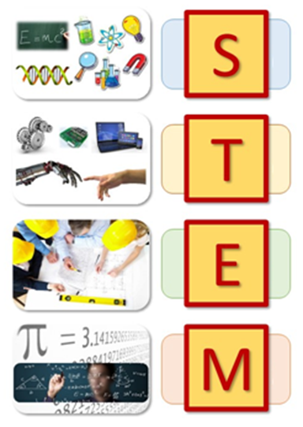
STEM subjects
Science
Physics, Biological Sciences, Chemistry, Food Science, Environmental Sciences
Technology
Design Technology, Computer Science
Engineering
Mechanical, Electrical & Electronic Engineering, Civil, Chemical
Maths
Mathematics, Business Management, Economics, Actuarial Mathematics

Slide 5
Why STEM?
Science is more than just a subject you study at school…
Being able to understand the world scientifically can also affect our lives in lots of fun and different ways
How much do you know about science?

Slide 6
Quiz
Your turn…
Here are 5 ‘facts’ about science, can you spot which are true or false (hint, some may be both!)?
Notes:
Can you ask students to put up their hand when asked True or False

Slide 7
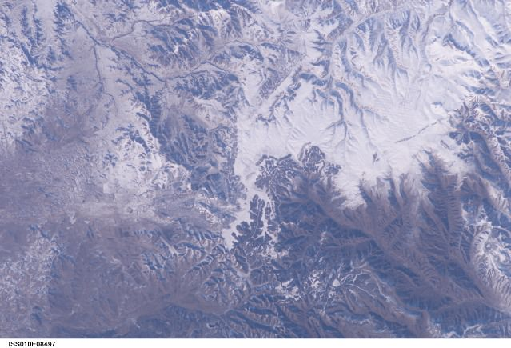
No.1
The Great Wall of China can be seen with the unaided eye from space
False
International Space Station Commander Leroy Chiao did take a photograph from the ISS in which you can just barely make out the Wall, but that's low Earth orbit and not actually space. It might be more accurate to say that the Great Wall is not visible from space without magnification.
Notes:
STEM skills can also be invaluable to all jobs. Calculating the dose of a child’s medication? Estimating costs for a build? Keeping a project on budget? How to fix your car?

Slide 8
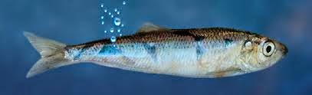
No. 2
Some fish communicate by farting
True
Scientists suspect herring communicate by expelling air bubbles from their anuses, which creates a high frequency sound of up to 22 kilohertz. It is suspected that these ‘farts’ are communication as they occur in darkness and large groups.
Notes:
STEM skills can also be invaluable to all jobs. Calculating the dose of a child’s medication? Estimating costs for a build? Keeping a project on budget? How to fix your car?

Slide 9
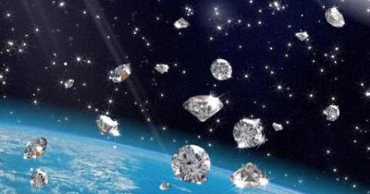
No. 3
It rains diamonds on Saturn and Jupiter
True (and False?)
New atmospheric data for the gas giants indicates that carbon is abundant in its dazzling crystal form.
But no one has actually seen any.
Notes:
STEM skills can also be invaluable to all jobs. Calculating the dose of a child’s medication? Estimating costs for a build? Keeping a project on budget? How to fix your car?

Slide 10
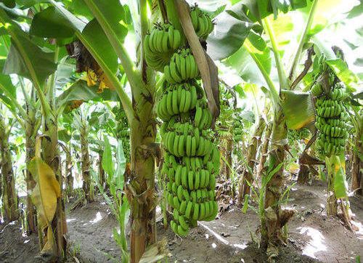
No. 4
Bananas grow on trees
False
Bananas do not grow on trees. They grow from a root structure that produces an above ground stem.
Notes:
STEM skills can also be invaluable to all jobs. Calculating the dose of a child’s medication? Estimating costs for a build? Keeping a project on budget? How to fix your car?

Slide 11

No. 5
Most people use only 10% of their brains.
False
You use all of your brain, just not all at once. This widely held science myth was disproved once scientists started imaging brain activity.
Notes:
STEM skills can also be invaluable to all jobs. Calculating the dose of a child’s medication? Estimating costs for a build? Keeping a project on budget? How to fix your car?

Slide 12

Will you be part of the problem?

Slide 13
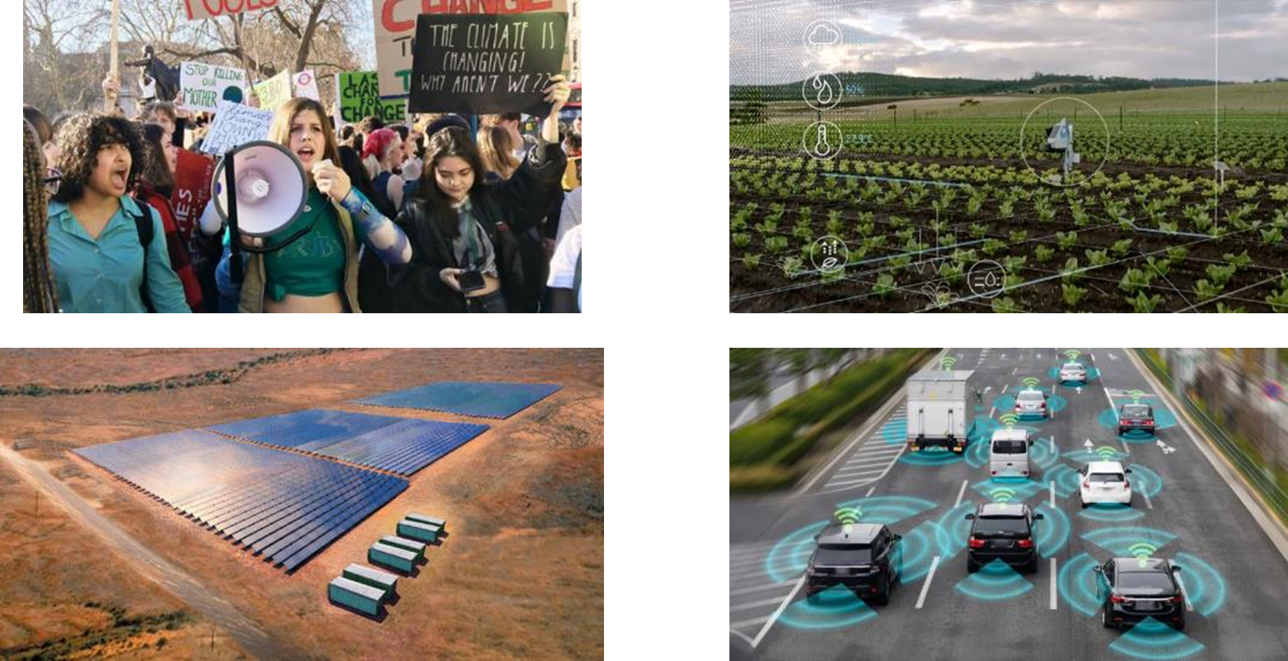
Or part of the solution?
Notes:
We need engineers to build sustainable solutions. It’s unlikely to be a literature or student that solves that problem.
Currently, 870 million people around the world do not have enough to eat.³ (out of 7.6 billion, roughly 11%)
Currently, 780 million people do not have access to clear water. Demand for water will exceed supply by 40% in the next 20 years.⁴ (out of 7.6 billion, roughly 10%)
3,000 people are killed on UK roads each year.⁵
The U.S. Energy Information Administration projects that world energy consumption will grow by 28% between 2015 and 2040. Fossil fuels are predicted to account for 78% of our energy by then.
How can agricultural practices be improved in order to minimize hunger around the world?
How can we improve access and sanitation to those in need?
In 2011, fossil fuels accounted for approximately 82 percent of the world's primary energy use, but this is expected to fall to 78 percent by 2040.
³ Smithsonian
⁴ Water Resources Group 2011
⁵ Blackpool Council, 2011.

Slide 14


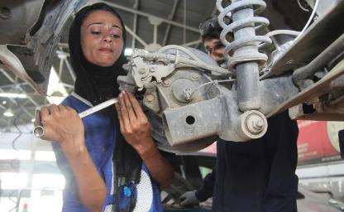
STEM Careers
Who uses STEM subjects as a job?
There is a huge variety of exciting career paths open to people with STEM based skills
How do you think STEM skills are relevant to these careers?
Add your career options here for the subject you are studying
Notes:
STEM skills can also be invaluable to all jobs. Calculating the dose of a child’s medication? Estimating costs for a build? Keeping a project on budget? How to fix your car?
Talk about your career options have studies your chosen subject at degree level. Does this involve a Masters and/ PhD, perhaps you could mention research here.
If you have time you could ask students if they have an idea of types of careers they would like to go into

Slide 15
STEM Careers
STEM related careers
agricultural engineer, animal scientist, bioacoustic researcher,
biomedical engineer, construction manager, crime scene investigator,
cyber security analyst, drone pilot, fashion designer, fish and game warden, forester, horticulturist, illustrator, kennel manager, marine geophysicist,
naval warfare officer, nurse, palaeontologist, quality control analyst,
robotics technician, tile & marble setter, underwater filmmaker,
video game designer, writer, zoologist
Non-science careers
For example 50% Biosciences graduates go on to do something that on the face of it seems completely unrelated to science, but utilises those key transferable skills
Notes:
Highlight why STEM skills are important and very employable

Slide 16
My career pathway
To add:
What year are you in?
degree are you taking
What has been your favourite module and why
What has been the most unusual module/topic you have covered
Add your chosen career/s here

Slide 17
University
How is a degree structured at University of Leeds?
Bachelors | Bachelors + Year in Industry / Study Abroad | Bachelors + integrated masters year | Bachelors + Year in Industry/Study Abroad + integrated masters year
Study Year 1 | Study Year 1 | Study Year 1 | Study Year 1
Study Year 2 | Study Year 2 | Study Year 2 | Study Year 2
Study Year 3 | Study Abroad | Study Year 3 | Year in Industry
 | Study Year 3 | Study Year 4 | Study Year 3
 |  |  | Study Year 4
Notes:
https://prezi.com/hxlboifv_nnb/master-updated-why-choose-leeds/?utm_campaign=share&token=9e8d049548aea23e8b18b29ac58f29c9c646b26891747de8a53be3ad8555ab43&utm_medium=copy
Think about your audience for this one! Only year 12’s might want the details, younger year groups can focus more on the year’s abroad/in industry. (Could mention Discovery Modules.)

Slide 18
Over to you
How much more can STEM graduates earn than their non STEM peers in their working life?
£25,000
£50,000
£90,000
£90,000. Graduates earn £160,000 more than non-graduates in their working life time, and STEM graduates tend to earn nearly £250,000 more.²
www.stem.leeds.ac.uk

Slide 19










Over to you
98% of our recent graduates are employed or in further study within six months of graduating (latest Destinations of Leavers from Higher Education survey 2016/17)
Do you recognise any of these brands?

Slide 20



Opportunities
Degree Apprenticeships
Long term careers
International travel
Notes:
Many large businesses offering STEM based apprenticeships (University of Leeds offers a Degree Apprenticeships in Computer Science with PwC)
Most science and engineering companies provide training opportunities and map out long term career paths
There is a demand for people with STEM skills globally, careers can often include the opportunity for international travel.

Slide 21
One last thought...
To add a “Quote” relating to a STEM subject/ career
<Name>, <when>
Optional: Left blank on purpose – IF you’re going to use a quote to finish off, you need to like/believe it too, so choose your own to go here.

Slide 22

Thank You

